Slide 1
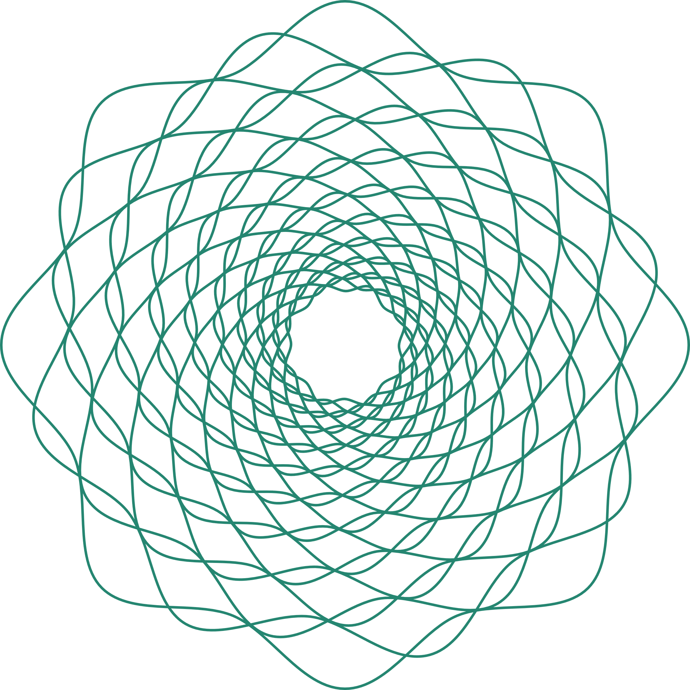
Game development
On Math Puzzle
2048

Slide 2

Team
Members
Upendra Saw
Niraj Pujari
Akshay Nair
Anas Shaikh
Mukti Shah

Slide 3
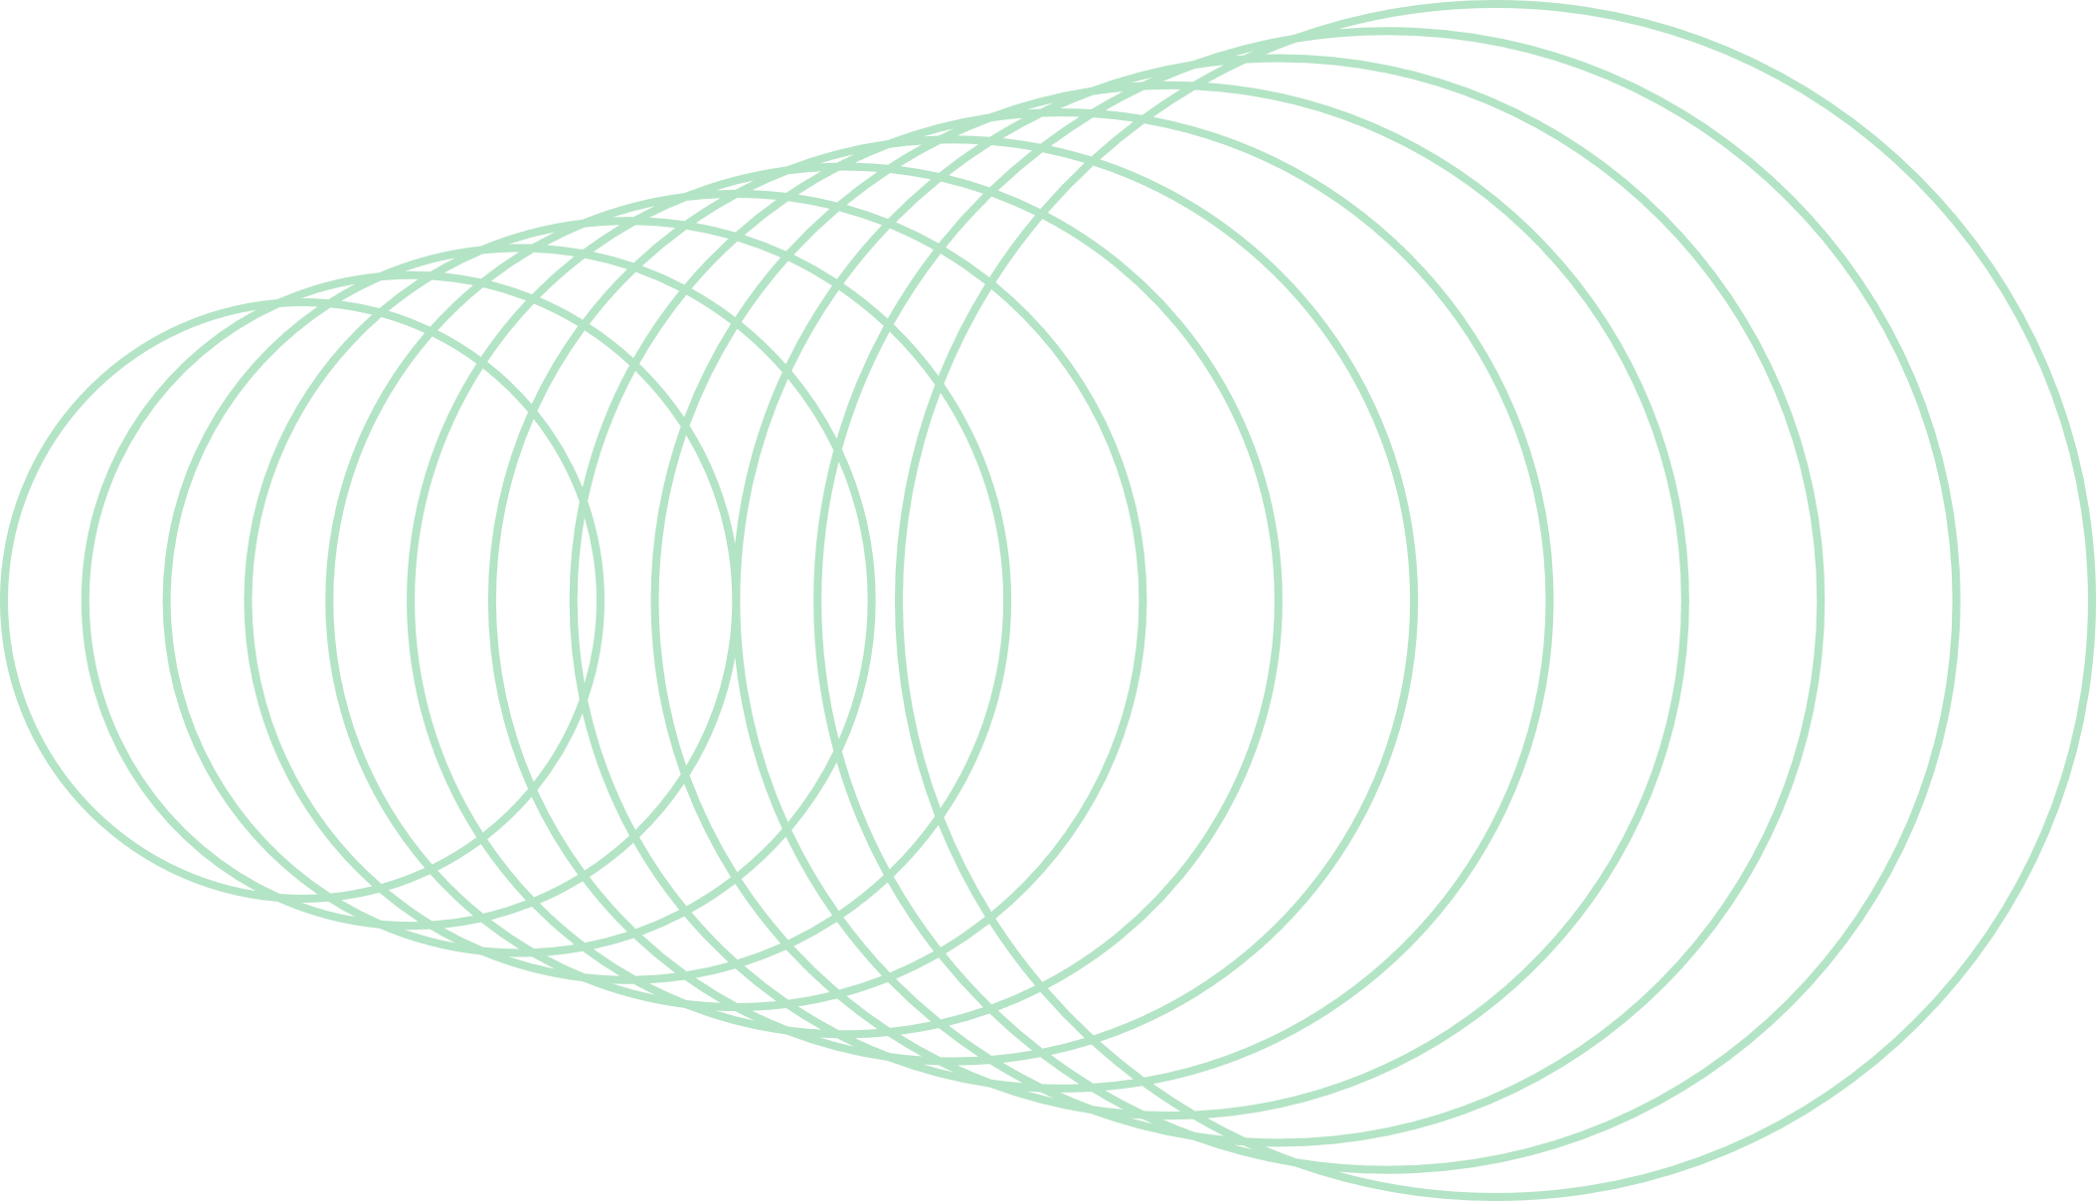
Agenda
Introduction to Python
Games in Python
Pygame
Pygame-Menu
Random
Numpy
Code
Output
Conclusion

Slide 4


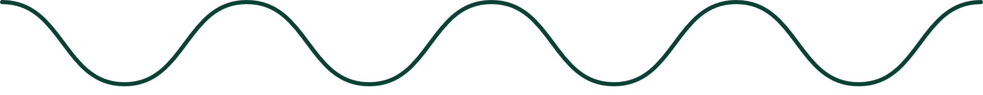
Introduction to Python
Python is an interpreted, object-oriented, high-level programming language with dynamic semantics.

Slide 5

Why Python?
Python works on different platforms (Windows, Mac, Linux, etc).
Python has a simple syntax similar to the English language.
Python has syntax that allows developers to write programs with fewer lines than some other programming languages.
Python runs on an interpreter system, meaning that code can be executed as soon as it is written. This means that prototyping can be very quick.
Python can be treated in a procedural way, an object-oriented way or a functional way.

Slide 6
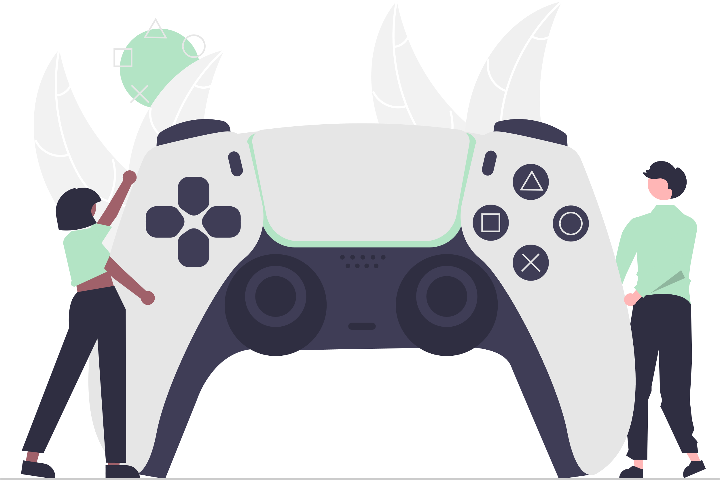

Games in Python
Python for game development has become a compelling choice for the entertainment industry.
It isn’t just because of the popularity of Python in other tech fields or because it’s free and open source.
Python is used in game development because it’s an incredibly versatile and powerful programming language.
It makes many of the most common tasks associated with game development quick and easy to accomplish.

Slide 7
Reasons for Game Development in Python
Clean Syntax
A clean syntax helps in the smooth implementation of the idea or logic, debugging becomes less complicated, and the ability to add features easily makes it an excellent choice for developing games.
Flexible Object Orientation
programmers can easily create new objects and modify existing ones without writing much code. It makes Python for game development an ideal choice as developers often need to create and update objects on the fly.

Slide 8
Gaming-based Libraries and Frameworks
Python for game development provides support to 2D graphics along with 3D graphics. It has many libraries and frameworks available that make game development easy.
Massive Community Support
Python has one of the largest and most active communities. If you’re stuck on a problem, chances are good that someone in the community has already faced and solved it.

Slide 9
Pygame
Pygame is a free and open-source cross-platform library for the development of multimedia applications like video games using Python.
Pygame is suitable to create client-side applications.
Games Developed using Pygame:
Flappy bird Snake Game
Sudoku Retro Racing Games

Slide 10
Pygame-Menu
Pygame-menu is a python-pygame library for creating menus and GUIs.
It supports several widgets, such as buttons, color inputs, clock objects, drop selectors, frames, images, labels, selectors, tables, text inputs, color switches, and many more, with multiple options to customize.

Slide 11
Random Module
The random module is a built-in module to generate the pseudo-random variables.
Methods:
random.random()
method returns a random float number between 0.0 to 1.0. The function doesn't need any arguments.

Slide 12
random.randrange()
method returns a randomly selected element from the range created by the start, stop and step arguments. By default The value of start is 0 and value of step is 1.
random.choice()
method returns a randomly selected element from a non-empty sequence.

Slide 13
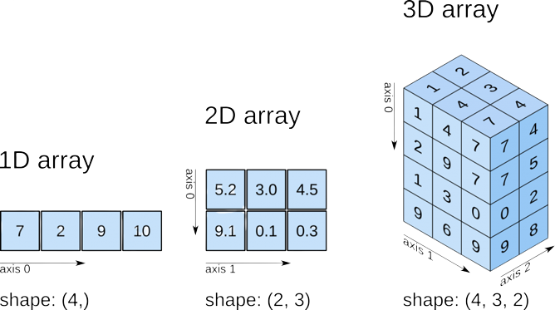
Numpy
NumPy is a Python library used for working with arrays.
NumPy stands for Numerical Python.

Slide 14

Why Use NumPy?
In Python we have lists that serve the purpose of arrays, but they are slow to process.
NumPy aims to provide an array object that is up to 50x faster than traditional Python lists.
NumPy arrays are stored at one continuous place in memory unlike lists, so processes can access and manipulate them very efficiently.

Slide 15
Methods:
numpy.zeros(shape, dtype=float)
Return a new array of given shape and type, filled with zeros.
numpy.where(condition)
Return elements chosen from x or y depending on condition.
numpy.array(object, dtype=None)
Create an array.
numpy.zeros_like(a, dtype=None)
Return an array of zeros with the same shape and type as a given array.

Slide 16
CODE

Slide 18
OUTPUT

Slide 19
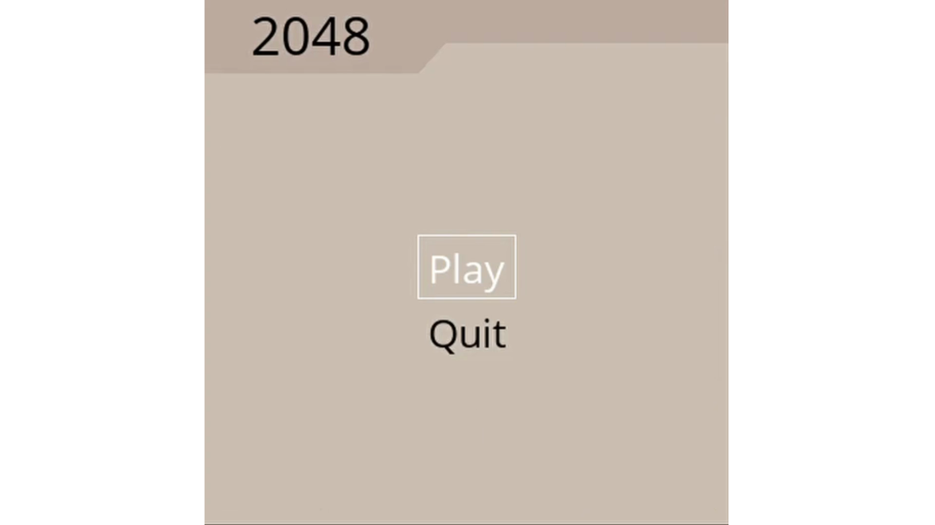

Slide 20
Bibliography:
https://pygame-menu.readthedocs.io/en/4.2.8/
https://www.w3schools.com/python/numpy/numpy_intro.asp
https://www.geeksforgeeks.org/numpy-in-python-set-1-introduction/
https://realpython.com/pygame-a-primer/
https://www.geeksforgeeks.org/python-random-module/
https://pypi.org/project/pip/

Slide 21
THANK YOU.

